Slide 1
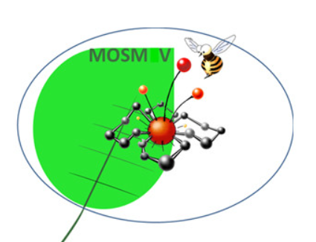
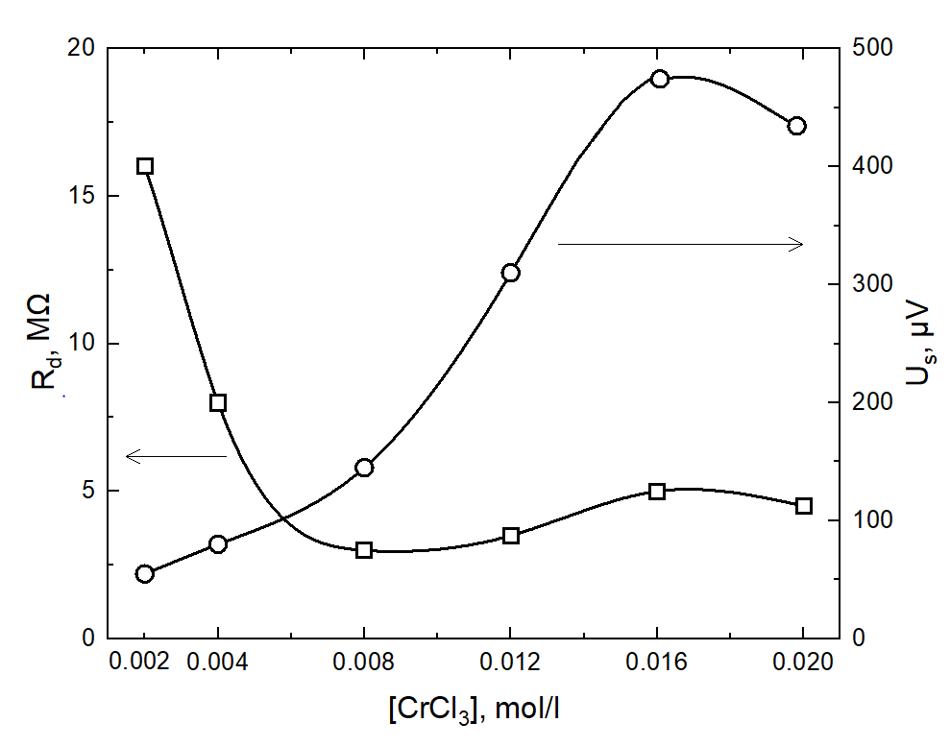
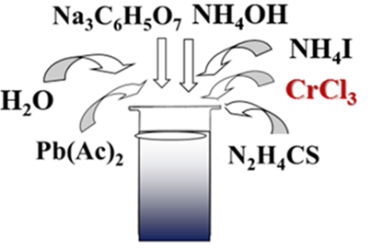
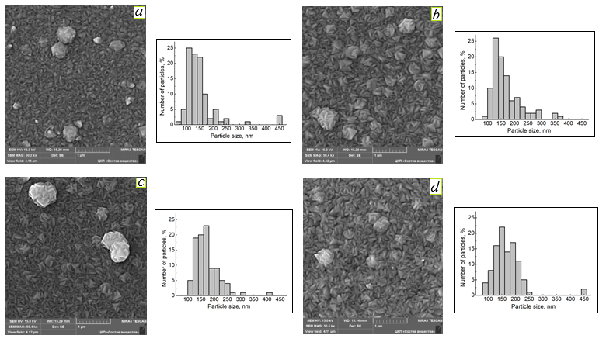
INFLUENCE OF DOPING CHROMIUM ON ELECTROPHYSICAL PROPERTIES OF CHEMICALLY DEPOSITED PbS FILMS
Pozdin A.V.¹, Maskaeva L.N.^{1,2}
¹ Ural Federal University named after the first President of Russia B.N. Yeltsin, Russia, Ekaterinburg
² Ural Institute of State Fire Service of EMERCOM of Russia, Russia, Ekaterinburg
E mail: andrej.pozdin@yandex.ru
Introduction
Most researchers show great interest in studying the doping of thin films with transition elements. One of the most common materials for alloying is lead sulfide PbS. Lead sulfide is a semiconductor material of the А^{IV}B^{VI} group, which has found wide application in many fields of science and technology. The introduction of Cr³⁺ ions into the reaction mixture during the chemical deposition of PbS thin films has affects on the photoelectric properties of the obtained thin-film layers.
In this regard, the purpose of this work was to study the morphology, composition, and photoelectric properties of chemically deposited PbS films doped with iodine and chromium with a grain size of more than 100 nm, which excludes the size effect.
Synthesis
Thin films of PbS (Cr) were obtained by chemical deposition from aqueous media.
Photoelectric properties
Deposition in a thermostat at a temperature of 353K for 90 min.
Fig. 2 Changing the dark resistance R_{d} and volt sensitivity U_{S} of elements (5×5) mm² based on films PbS (I,Cr) from the concentration of CrCl₃ in the reaction bath
Fig. 1. Synthesis procedure
Electron microscopic studies
Elemental composition and structural characteristics of PbS(Cr) films synthesized on a glass substrate
[CrCl₃], mol/l | Content of elements in the film, at. %
 | Pb | S | I | Cr
0 | 49.8 | 48.3 | 1.9 | -
0.008 | 47.97 | 50.05 | 1.98 | -
0.012 | 48.02 | 49.83 | 2.11 | 0.62
0.016 | 47.98 | 48.82 | 2.11 | 1.08
0.02 | 47.74 | 50.32 | 1.47 | 0.47
Fig. 3. Electron microscopic images of PbS(I,Cr) films obtained from a reaction bath with a chromium (III) chloride content, mol/l: 0.008 (a), 0.012 (b), 0.016 (c), 0.020 (d) and distribution histograms they contain particles by size
Conclusions
By the method of chemical deposition from aqueous solutions from the studied reaction systems, thin films of PbS(Cr) with a thickness of 420-520 nm were obtained.
It is shown that the introduction of a chromium salt into the reaction mixture does not change the cubic crystal structure of lead sulfide and does not significantly affect the morphology of films with an average crystallite size from ~ 100 to ~ 225 nm with their monomodal distribution.
The performed EDX analysis showed that the thin-film layers doped simultaneously with iodine and chromium PbS(I,Cr) contain 47.74- 48.02 at.% lead and 48.82-50.32 at.% sulfur. In the PbS (I, Cr) films, a dopant transition element was found locally in an amount from 0.47 to 1.08 at.%.
The dependence of the voltaic sensitivity on the concentration of chromium salt in the reaction bath has an extreme character with a maximum at 0.016 mol/l, which is associated with the nonmonotonic incorporation of chromium into the PbS lattice.
The work was financially supported by program 211 of the Government of the Russian Federation (No. 02.A03.21.0006.)

