Slide 1
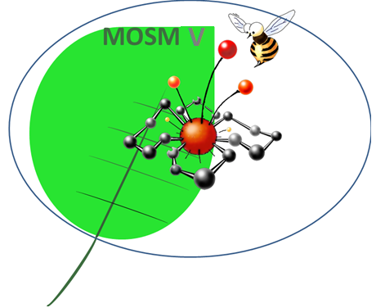
V International Conference
Modern Synthetic Methodologies For Creating Drugs And Functional Materials
(MOSM 2021)
8-12 November 2021, Ekaterinburg-Perm, Russia
https://mosm.urfu.ru/ru/
Dear colleagues!
We invite you and your colleagues to take part in the anniversary V International conference "Modern Synthetic Methodologies For Creating Drugs And Functional Materials" (MOSM 2021), which will be held from November 8 to 12, 2021. The conference events will be held at the Ural Federal University named after the first President of Russia B.N. Yeltsin at the site of the Innovation Center for Chemical and Pharmaceutical Technologies (Yekaterinburg, Mira St., 21) and at the Perm State National Research University (Perm, Bukireva St., 15).
Deadline for registration and submission of abstracts on October 15, 2021.
You are given the opportunity to publish your reports in the form of articles in English in thematic issues of the journals:
Chimica Techno Acta (CTA) (Scopus),
Applied Magnetic Resonance (Scopus/WoS) (Special issue: Magnetic resonance in molecular biology, biophysics and biochemistry), as well as in Russian or in English thematic issues of the journals:
Chemistry of Heterocyclic Compounds (Scopus/WoS), Russian Journal of Organic Chemistry (Scopus/WoS), Russian Chemical Bulletin (Scopus/WoS), Proceeding of the Perm University (RINZ), Bulletin of the SUSU (Issue: Food and Biotechnologies) (VAK).
It also remains possible to publish reports in the journal AIP Conference Proceedings (Scopus).
The conference program includes plenary lectures, oral and poster presentations, as well as discussions in the framework of round tables and symposia on topics: Reactions of direct -C-C- and -C-X- couling for the synthesis of building blocks, ligands and bioactive molecules; Photoactive materials, dyes and chemosensors: synthesis, properties and applications; New synthetic methods, including the methods of PASE- and "green chemistry", including for the needs of medical and pharmaceutical chemistry; (Bio) chemoinformatics. Mathematical modeling of chemical and biological processes; Environmental chemistry, including chemosensors and technogenic waste extractants; Supramolecular chemistry, molecular recognition and chemistry of functional materials; Inorganic and coordination (bio) chemistry, including new functional (bio) inorganic materials, sorbents and catalysts and methods of their research; Instrumental methods, including magnetic resonance, in the study of chemical, physical and biological objects and processes; Chemical technology, including processes and apparatus; Modern approaches and methods in plant protection; Agrochemistry, food chemistry and biotechnology, including technologies for obtaining biologically active substances and other promising molecules from natural raw materials and food waste; Electrochemical materials science; New reagents for rational subsoil use; Chemical education (round table). | Plenary Speakers: M. Artem’ev (BSU, Belarus); S. Achelle (University of Rennes, France); A. S. K. Hashmi (University of Heidelberg, Germany); D. Werz (Technical University of Braunschweig, Germany); A. Antonchick (Nottingham Trent University, UK); A. Yudin (University of Toronto, Canada); A. Malkov (Loughborough University, UK); M. Kotora (Charles University, Czech Republic); G. E. Vassilikogiannakis (University of Crete, Greece); K. Lam (University of Greenwich, UK); B. Maes (University of Antwerpen, Belgium); B. Ośmiałowski (Nicolaus Copernicus University, Polish); M. Tsurkan (Leibniz Institute of Polymer Research, Germany); Zh. Wang (Beijing University of Chemical Technology, China); R.V.S.S.N. RAVIKUMAR (Acharya Nagarjuna University, India); P. Das (Institute of Technology of Himalayan Bioresources, India); J.R. Garcia (University of Ponta-Grossa, Brazil); A. Hajra (Visva-Bharatti (A Cental Univeristy, India); R. Gokare (Dayananda Sagar Institutionы & Dayananda Sagar University, India) G. Lazzara (University of Palermo, Italia); R. Bhatt (Estonian University of Life Sciences, Estonia); H. Li (Central China Normal University, China). Academisian of the RAS К.М. Salikhov (FRC KazRC, KPhTI named Е.К. Zavoiskii, KazRC of the RAS, Kazan); Doctor of Physics and Mathematics E.G. Bagryanskaya (NIOCh named after N.N. Vorozhtsov SB RAS, Novosibirsk); Doctor of Technical Sciences I.Yu. Potoroko (SUSU, Chelyabinsk)
We will be glad to see you in Yekaterinburg and Perm!

